Slide 1
Effects on Canadian Gas Prices
A five to ten year historical analysis
Capstone Project 1
By: Kevin Phan

Slide 2
Problem Statement
Canadian gas prices have spiked irregularly throughout the past five to ten years. By exploring trends between major cities including internal and external factors, we can determine how these prices came to be and what to expect from new gas prices moving forward
Data to explore:
Average Canadian gas prices & tax statuses between Canadian major cities
Refined Petroleum and Crude Oil Imports
The carbon tax
A major economic disturbance within the past decade

Slide 3
What’s to come
Data to explore at a glance
Data cleaning
Data trends
Data correlations
Final insights and key points

Slide 4
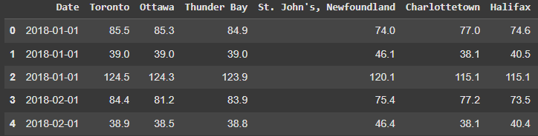
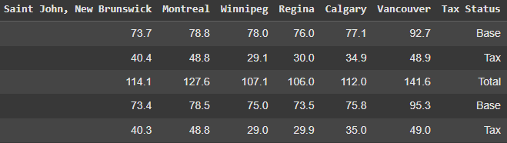
Canadian Gas Prices
Canadian major cities and their average gas prices including the dates Further categorized by tax status. Total price is the sum of Base and Tax Tax Status
Source: https://data.ontario.ca/dataset/gasoline-report-canadian-gasoline-prices

Slide 5
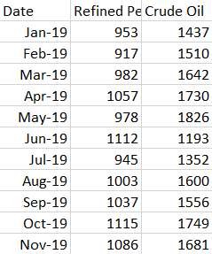
Refined Petroleum and Crude Oil Imports
Import prices by the millions including the dates
Source: https://www150.statcan.gc.ca/n1/daily-quotidien/220607/cg-a004-eng.htm

Slide 6
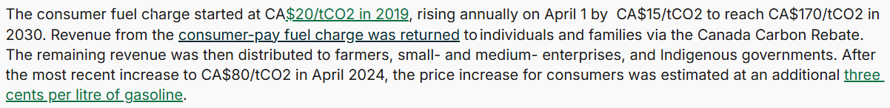
Hard Hitter Factors
Major Economic Disturbance - None other than the COVID-19 pandemic - Lockdown from March 2020 to 2022
Carbon Tax - A regulatory tax meant to curb carbon content in products such as fuel - The steady growth of the carbon tax since it’s introduction:
Source: https://www.carbon-direct.com/insights/the-future-of-carbon-pricing-in-canada-after-the-2025-election

Slide 7
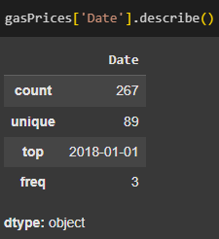
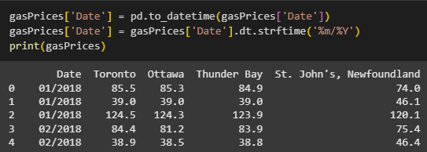
Data Cleaning
Fix:

Slide 8
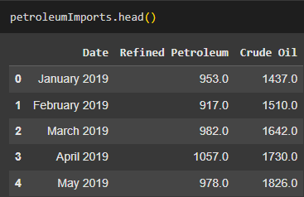

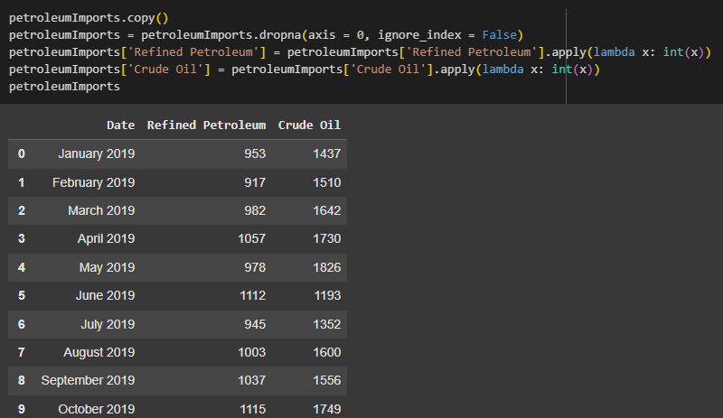
Fix:

Slide 9


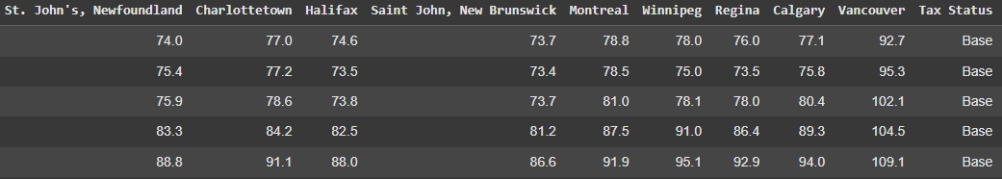
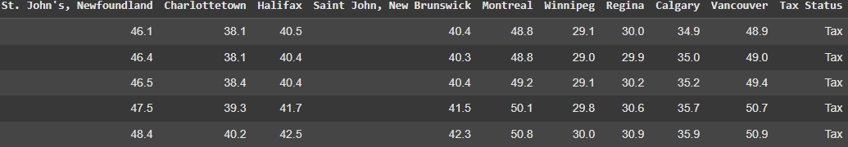

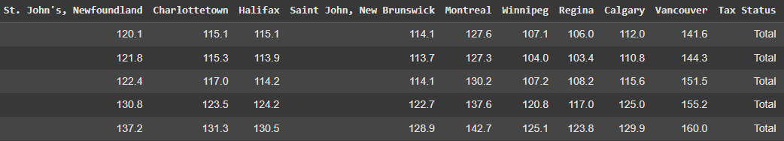
Some Data Extraction

Slide 10
Data Trends
Overview
Average total gas prices
Average tax on gas prices
Average base gas prices

Slide 11
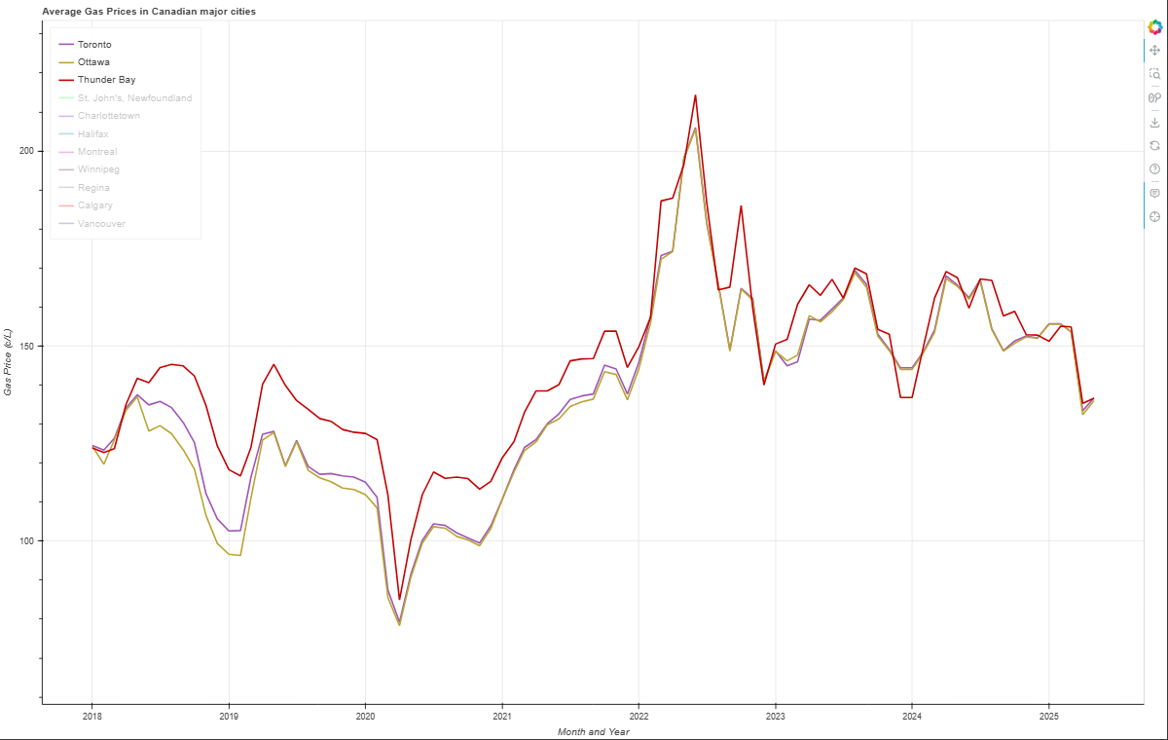
Ontario

Slide 12
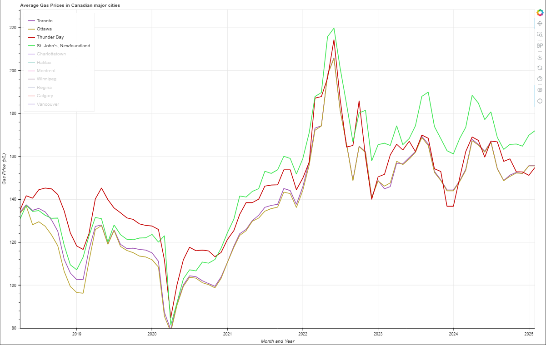
Ontario & Newfoundland

Slide 13
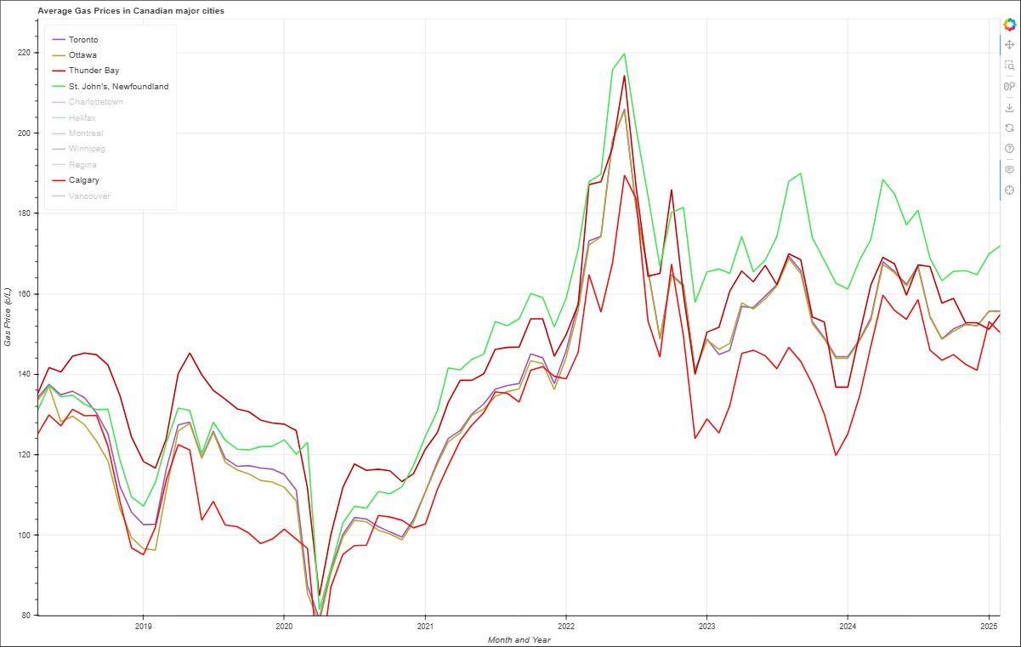
Ontario, Newfoundland, Alberta

Slide 14
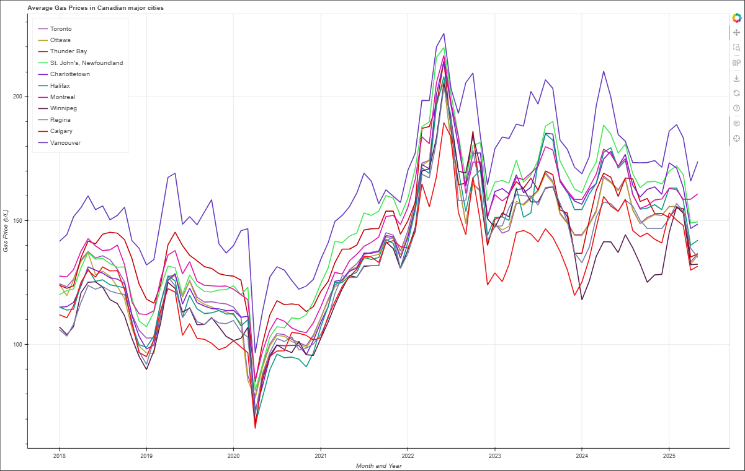
All

Slide 15
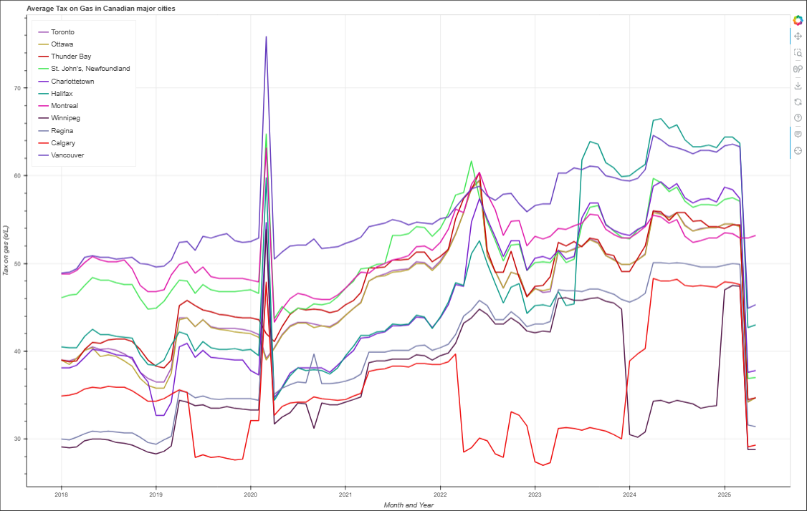

Slide 16
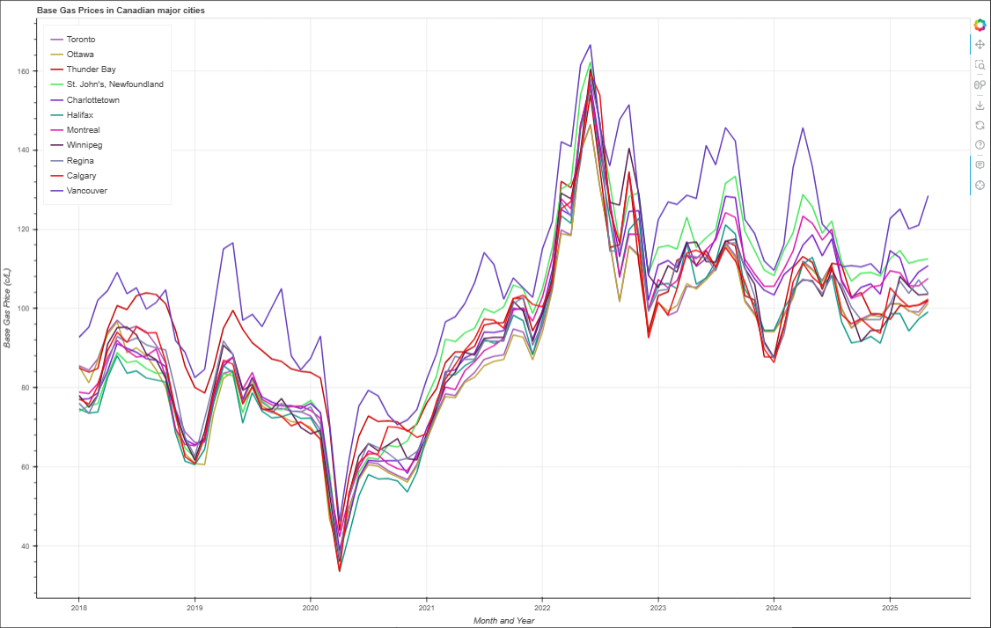
Base
Total

Slide 17
Data Correlation
Overview
COVID-19 and Refined Petroleum & Crude Oil Imports relationship
Base Gas Prices and Refined Petroleum & Crude Oil Imports relationship
Gas Prices during peak COVID-19 period vs. mean gas price of each city
Tax on gas prices and the (now) former Carbon Tax relationship (Inception and the election’s changes)

Slide 18
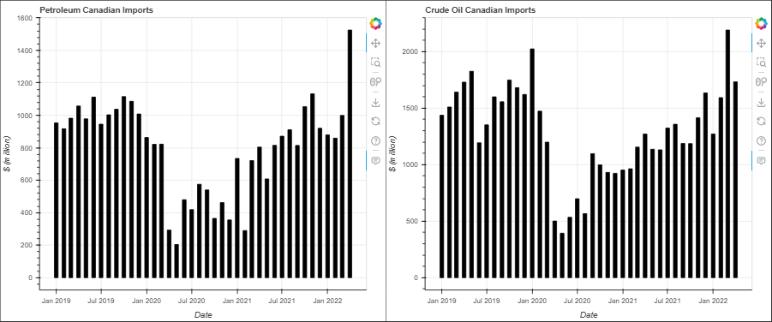
Note: Data only shown is between 2019 and Q1 2022

Slide 19
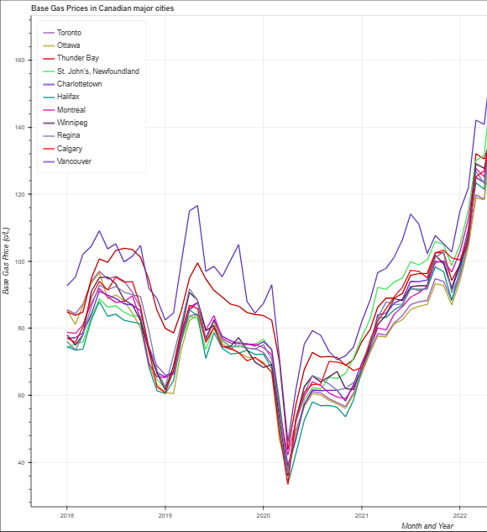

Slide 20
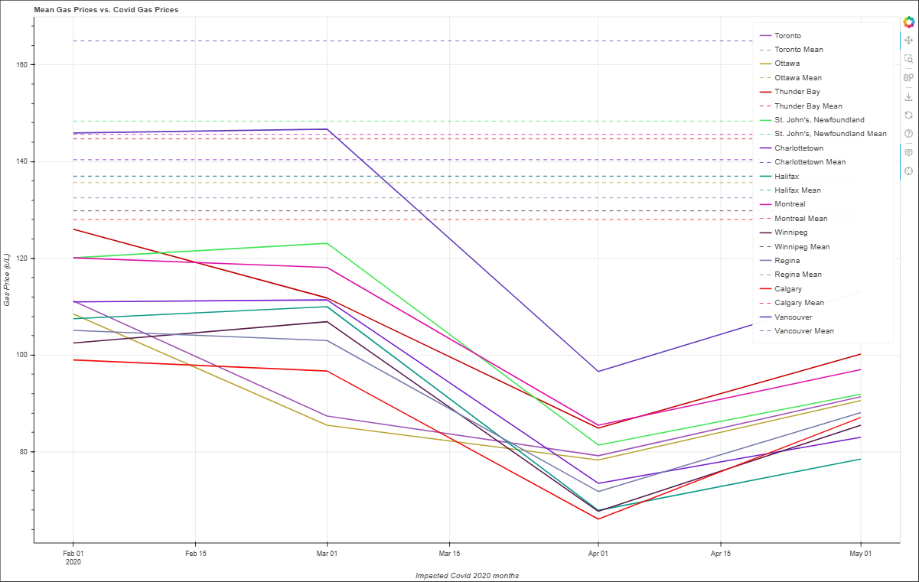

Slide 21
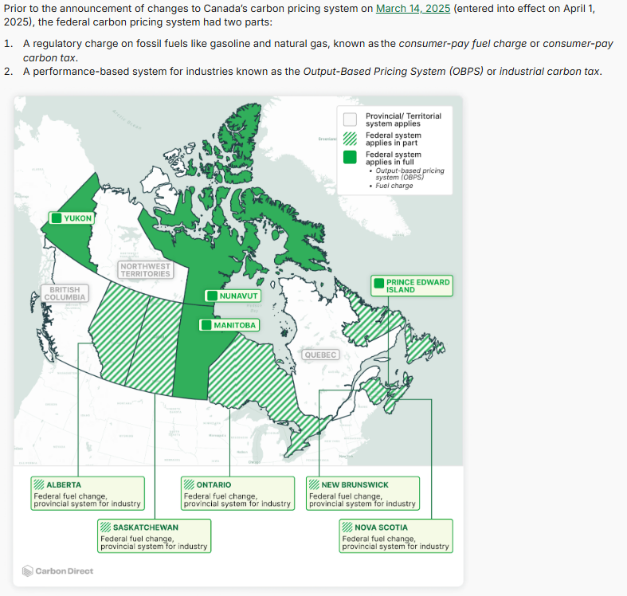
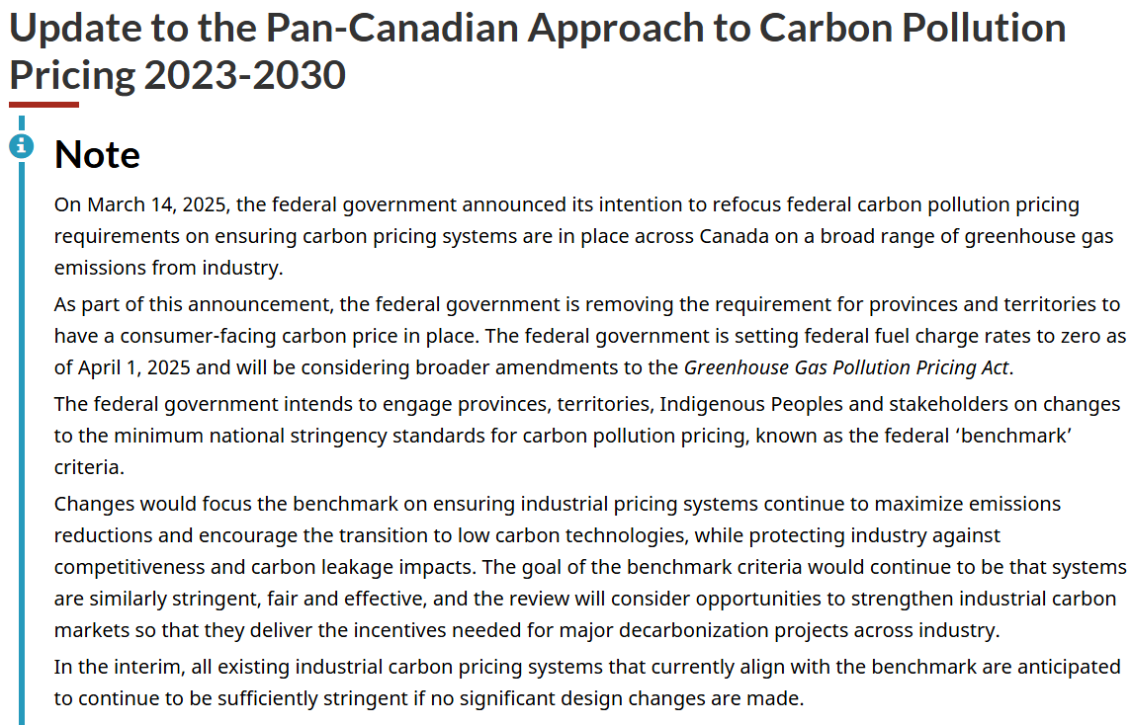
Source: https://www.canada.ca/en/environment-climate-change/services/climate-change/pricing-pollution-how-it-will-work/carbon-pollution-pricing-federal-benchmark-information/federal-benchmark-2023-2030.html
Source: https://www.carbon-direct.com/insights/the-future-of-carbon-pricing-in-canada-after-the-2025-election

Slide 22
Final Insights and Key Points
Amount of refined petroleum & crude oil imports has a direct influence on base gas prices
The carbon tax plays a role in how gas prices have spiked throughout the past 5-10 years
We can expect gas prices to steadily decrease with the overhaul of the carbon tax at the federal level and if the amount of petroleum and crude oil import is not excessive

